Slide 1



UNIT 4
LESSON 15
Healthy and happy
Part 1

Slide 2
mekano
gazirano
fizzy
soft
ukusno
tasty
fatty
masno
FOOD
alkoholno
alcoholic
unhealthy
nezdravo
nadjev
filling
sour
kiselo
hrskavo
crunchy
greasy
masno
sweet
zdravo
healthy
salty
slatko
spicy
slano
začinjeno, pikantno

Slide 3
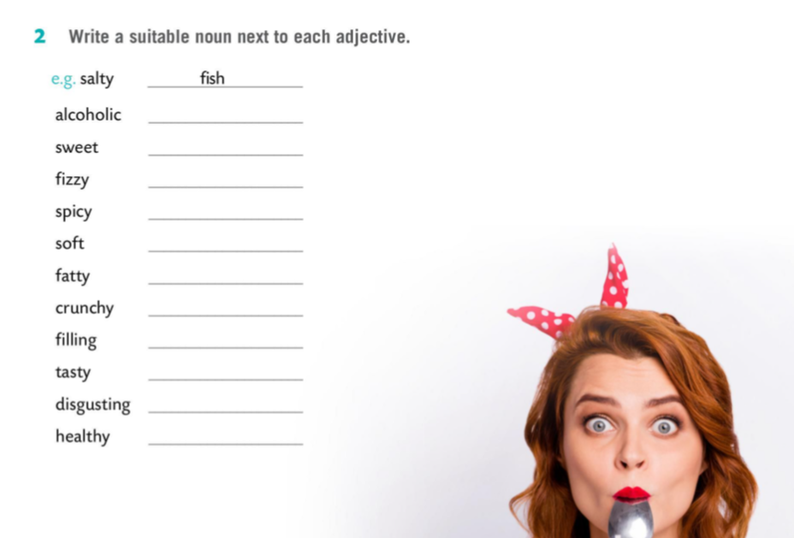

Slide 4
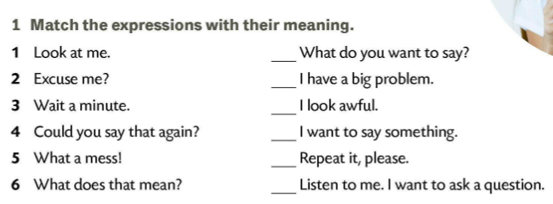

6
5
1
2
4
3
Talk about these four different types of food, their characteristics, the good/bad sides, if they are expensive, if they are convenient, who eats them, etc.

Slide 5
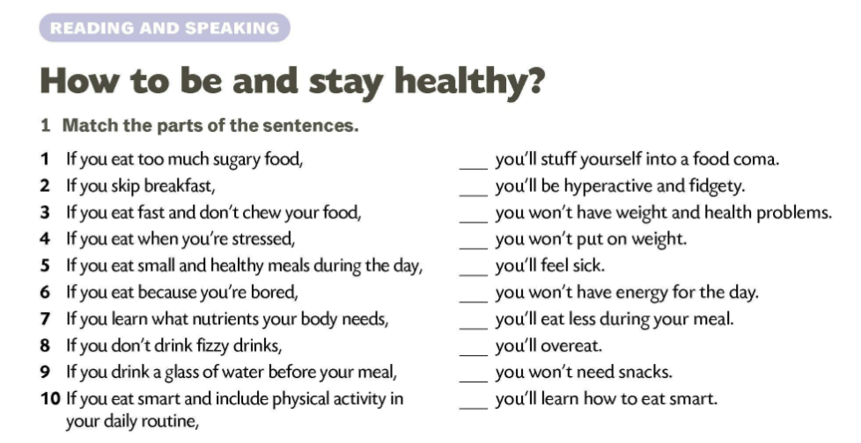
4
1
10
8
3
2
9
6
5
Pay attention to the form of the verb in the sentences.
7

Slide 6
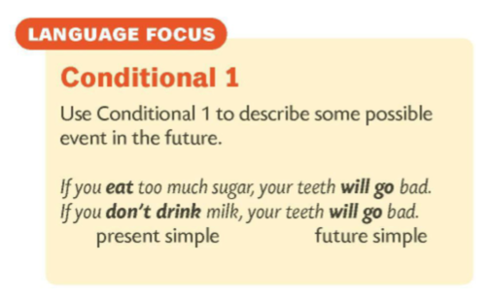
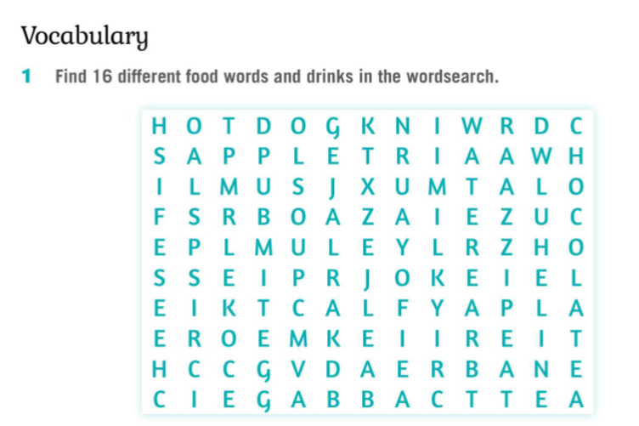
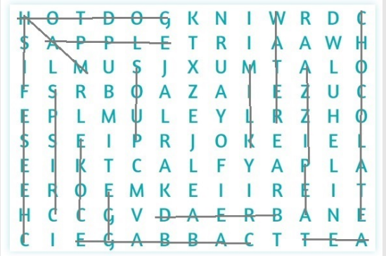


Slide 7
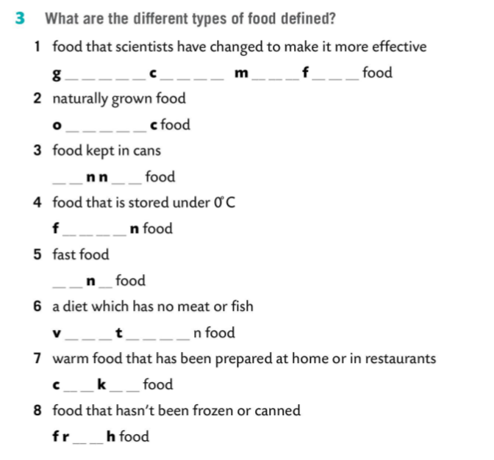
genetically modified
organic
canned
frozen
junk
vegeterian
cooked
fresh

Slide 8
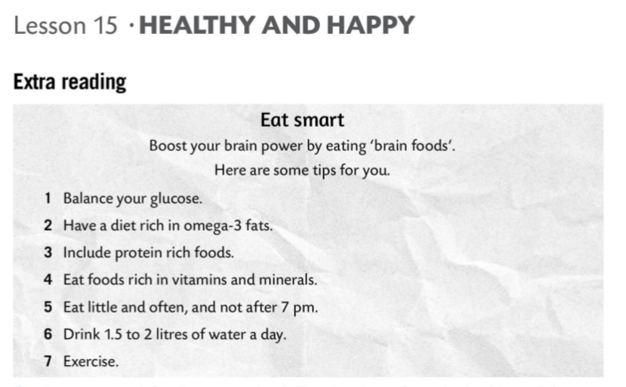

Slide 9
